Slide 1
Word Prediction with LSTM (Long Short-Term Memory)
By Keagan Authement

Slide 2
What is LSTM?
LSTM stands for Long Short-Term Memory. It's a type of recurrent neural network (RNN), designed to learn long-term dependencies in sequential data. Traditional RNN models often struggle with capturing long-range dependencies due to the vanishing gradient problem, where information gets lost as it propagates through time steps.
LSTM has a memory cell and a set of gates that control the flow of information into and out of the cell. These gates include the input gate, forget gate, and output gate. The input gate controls the extent to which new information is stored in the cell, the forget gate controls the extent to which old information is erased from the cell, and the output gate controls the extent to which the information in the cell is used to compute the output.

Slide 3
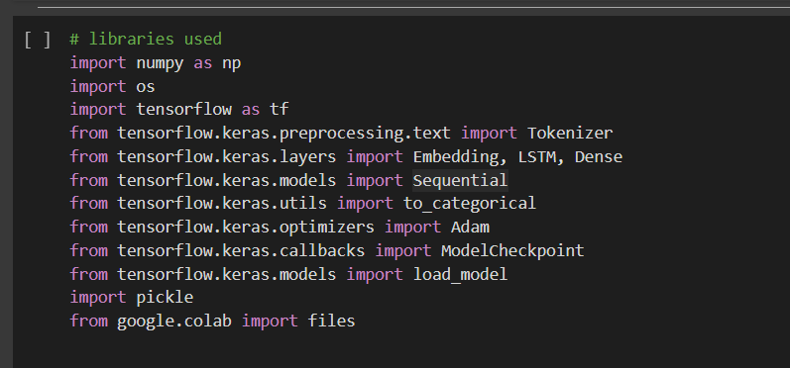
Libraries
Most Libraries imported from TensorFlow
These libraries are used to create and train the learning model

Slide 4
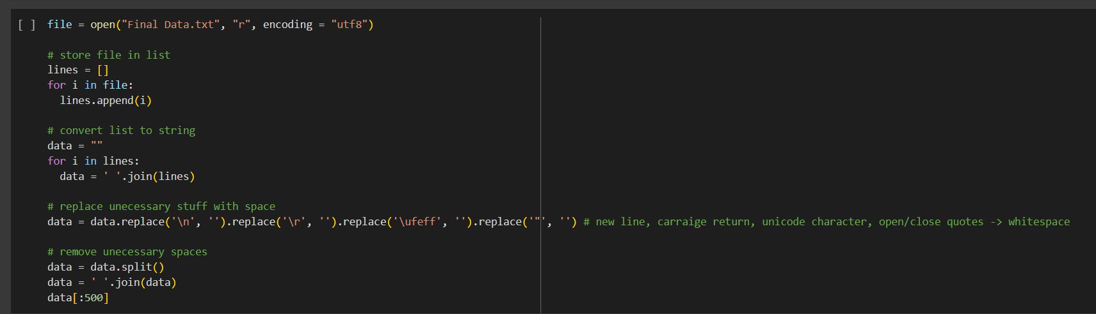
Loading the Text File
Using the Files import, get the txt file that the program will read from
Convert all text into plaintext

Slide 5
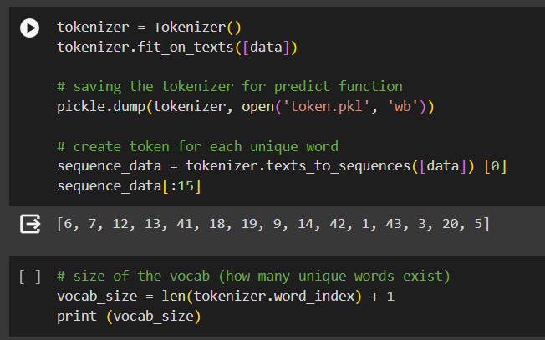
Creating Data
Initialize the Tokenizer and create unique tokens
Get and show amount of unique words

Slide 6
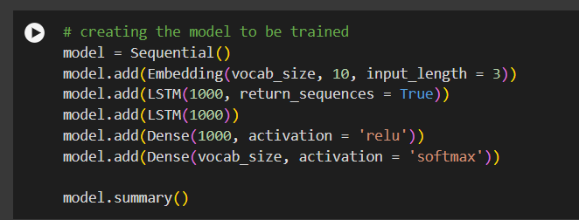
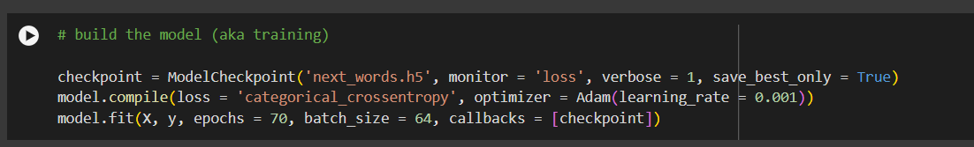
Training Model
Create the model with training rules and activation
Train models and save best preforming model

Slide 7
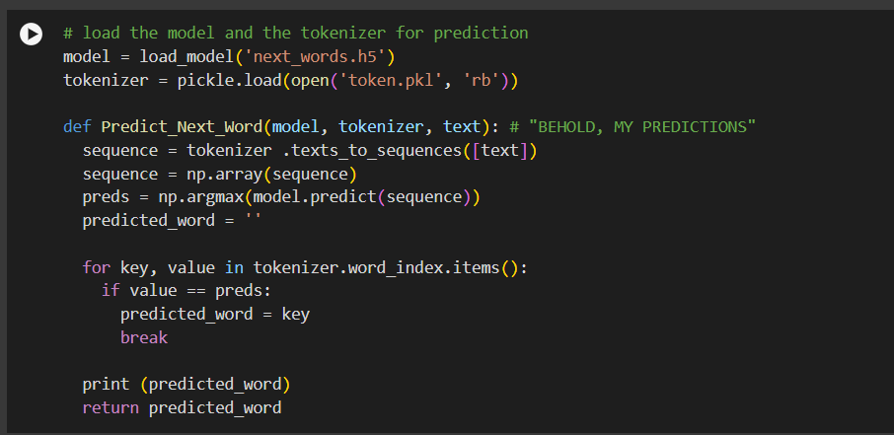
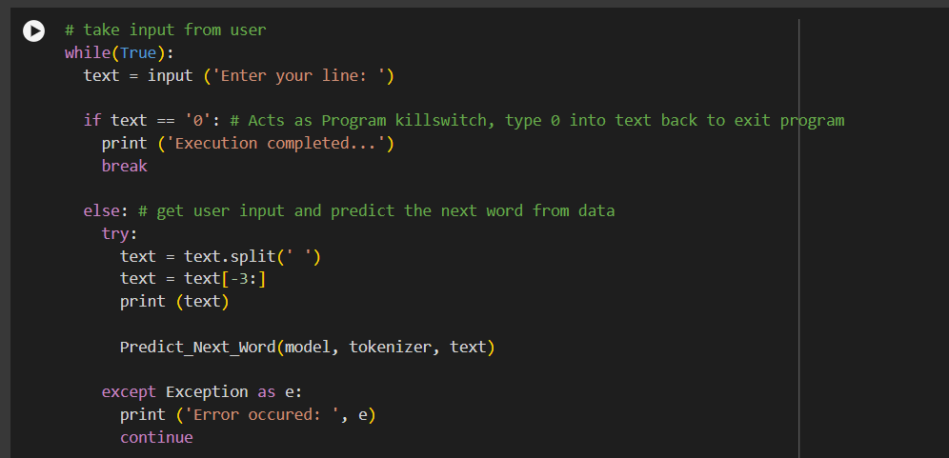
Model in use
Load model and text data
Given text input, find the predicted word in sequence and return the word
Via infinite loop, ask user for some text and show prediction for the next word

